Slide 1
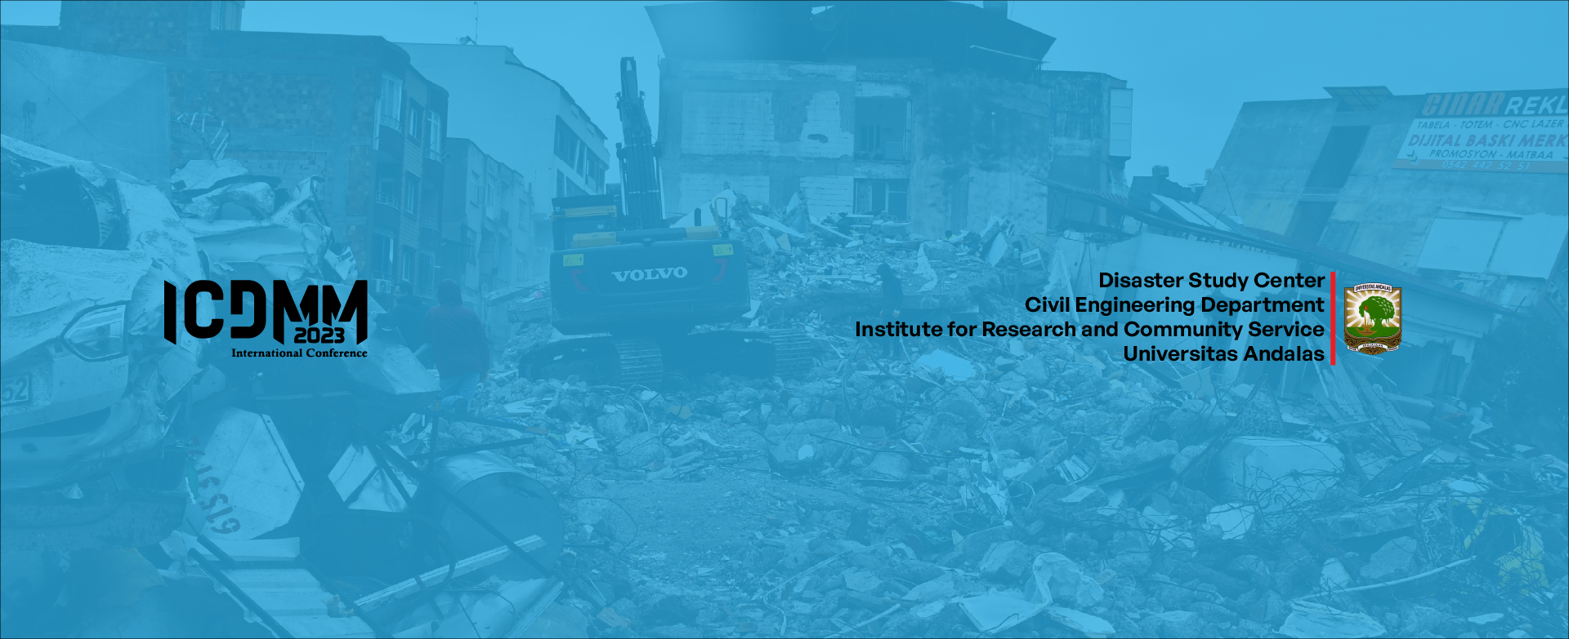
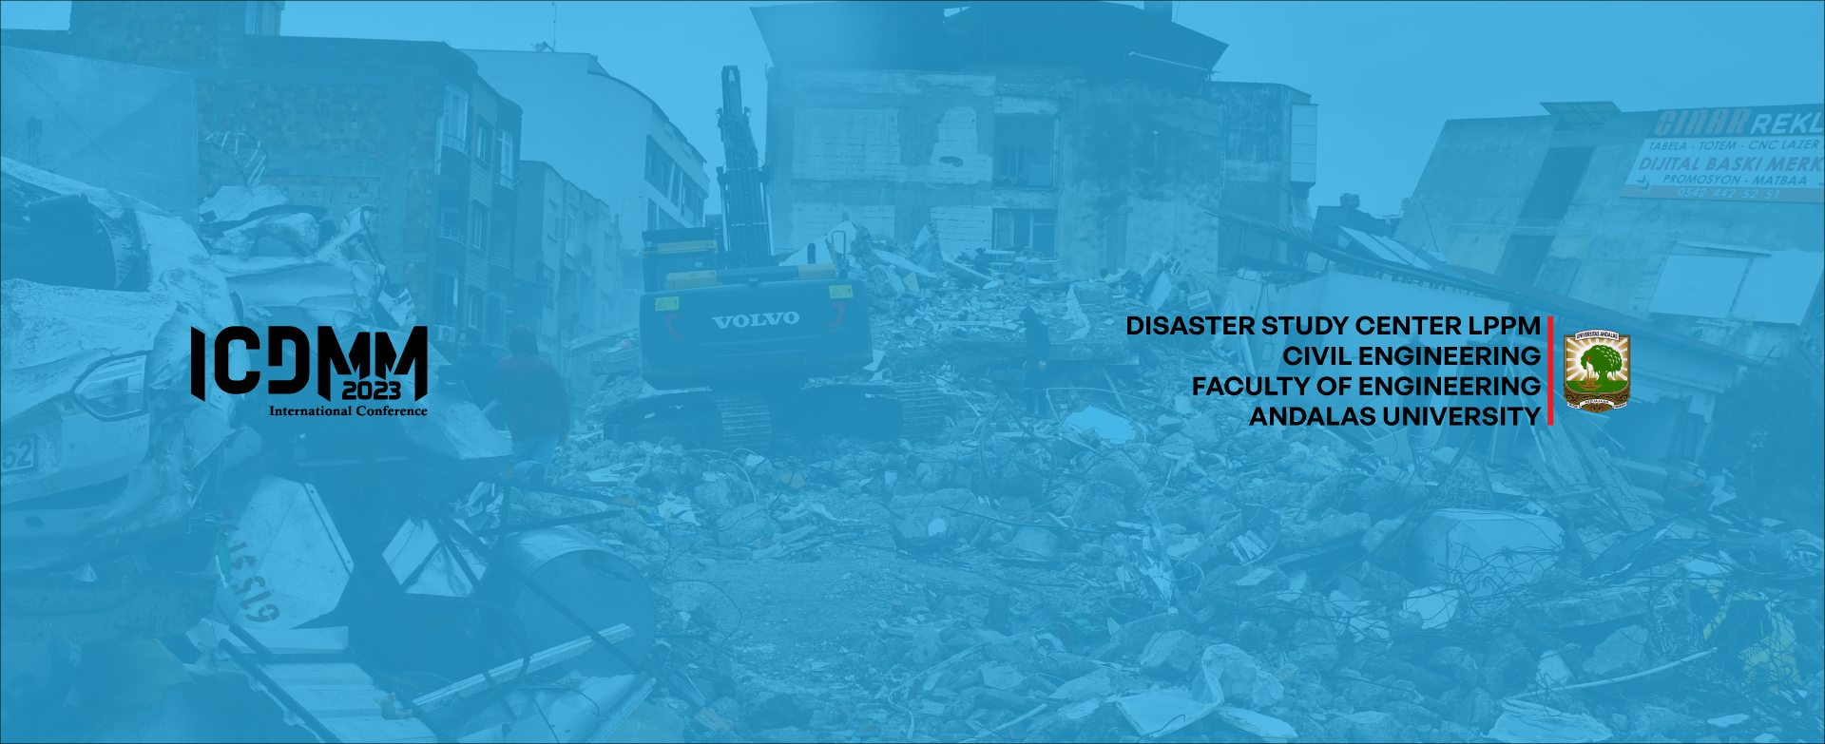



THE 2 INTERNATIONAL CONFERENCE ON
DISASTER MITIGATION AND
MANAGEMENT
nd
2023
Co-Host

